Slide 1

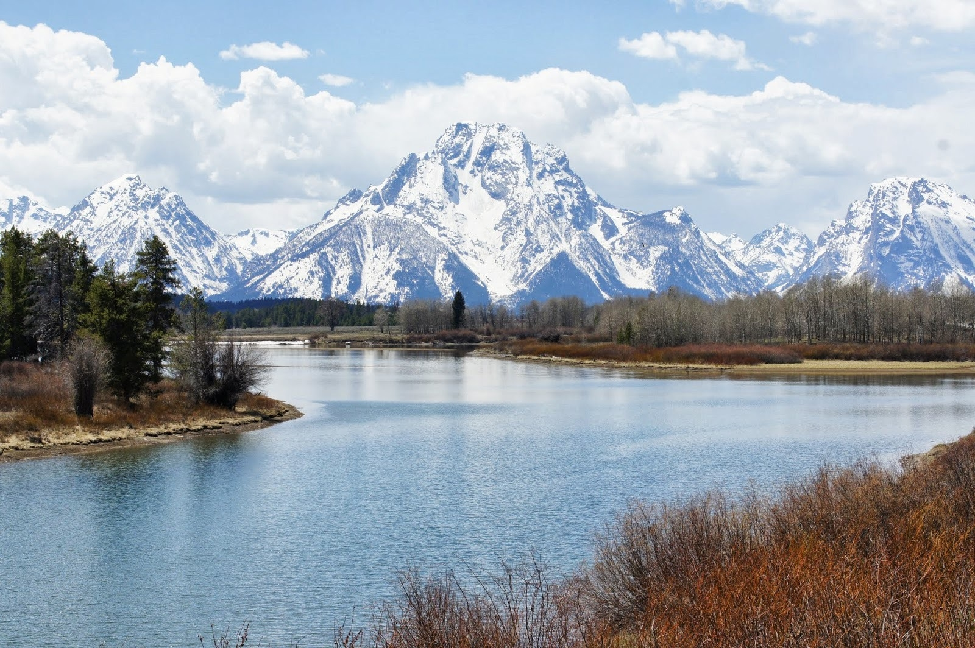
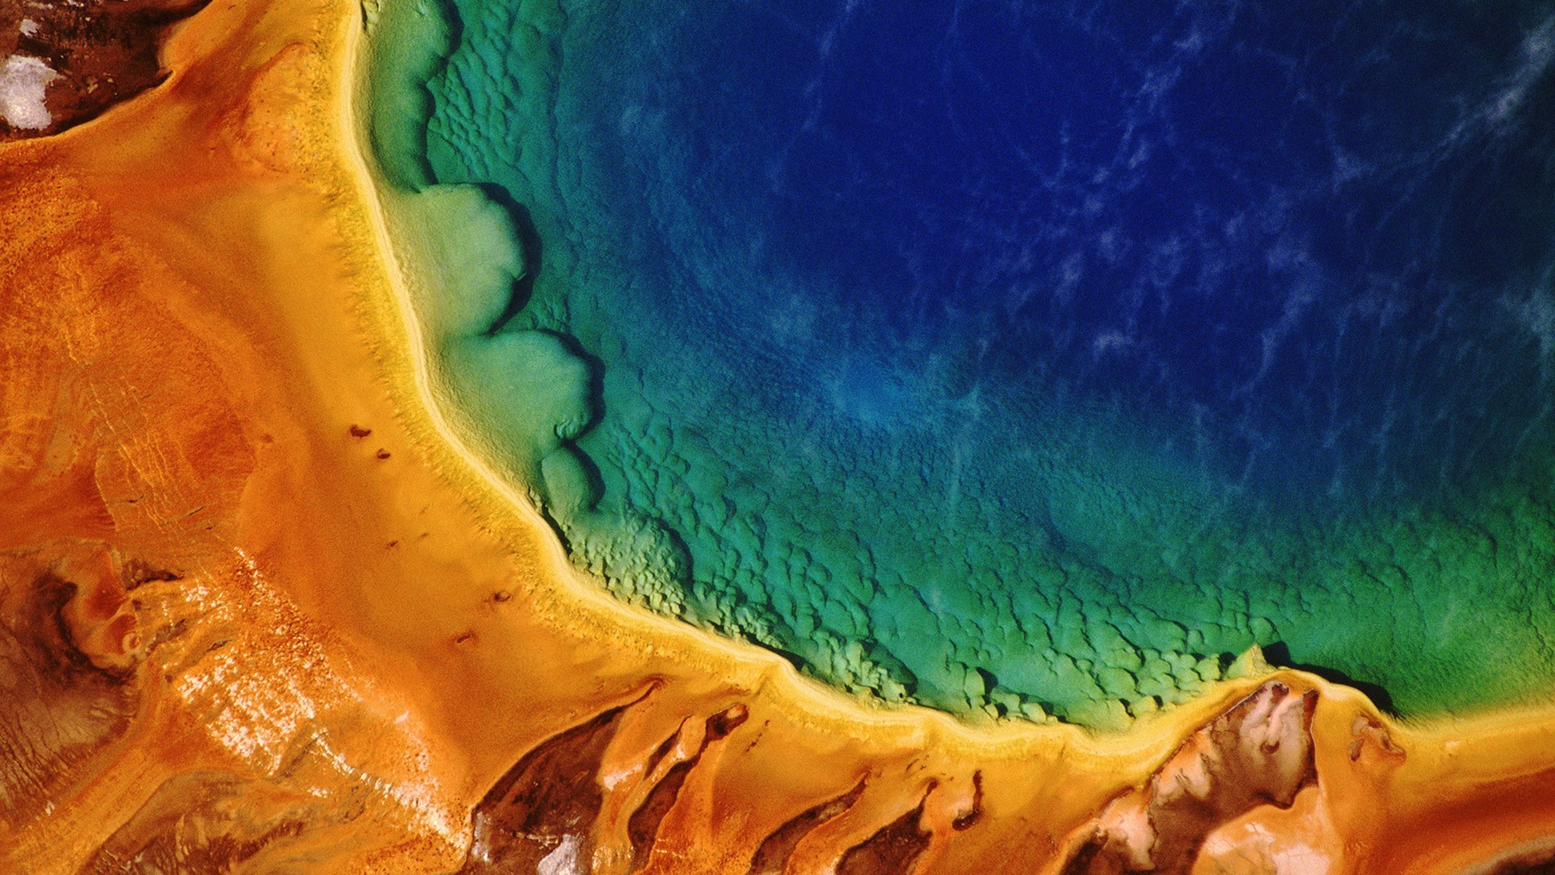
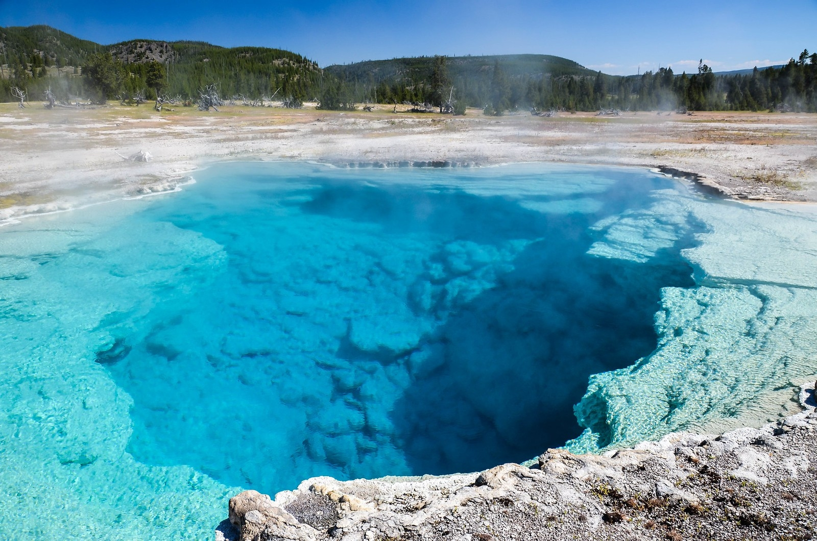
Economical Trip
Happy Go Travel
We’ve launched two promotional programs that is go to the Yellowstone.
One is luxurious plan.
This plan price is a little high because you will live in five stars hotel and take you to the high-level restaurant enjoy noble life.
Another plan is cheap plan.
This plan is suitable for someone who want to travel but don’t have sufficient budget.
YELLOWSTONE
AMAZING & BEAUTIFUL TOUR
INTRODUCTION
Plans
Luxury Plan
49,000
Budget Plan
36,850
Yellowstone was the first national park in the U.S. and is also widely held to be the first national park in the world. The park is known for its wildlife and its many geothermal features, especially Old Faithful geyser, one of its most popular.

Slide 2
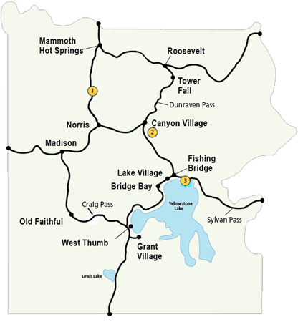
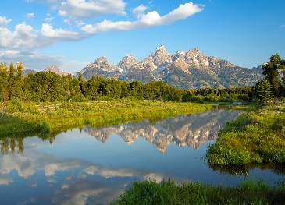
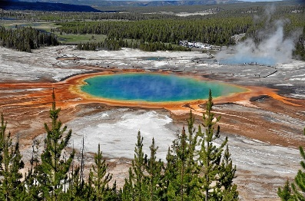
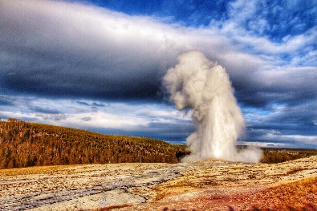
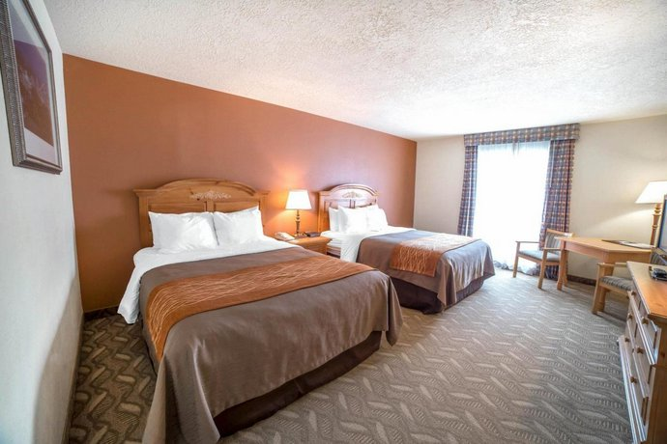
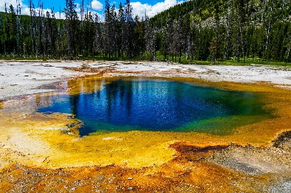
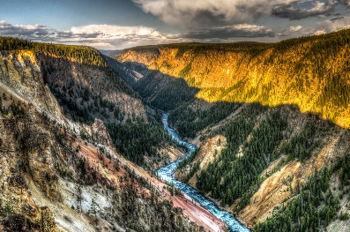
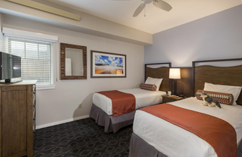
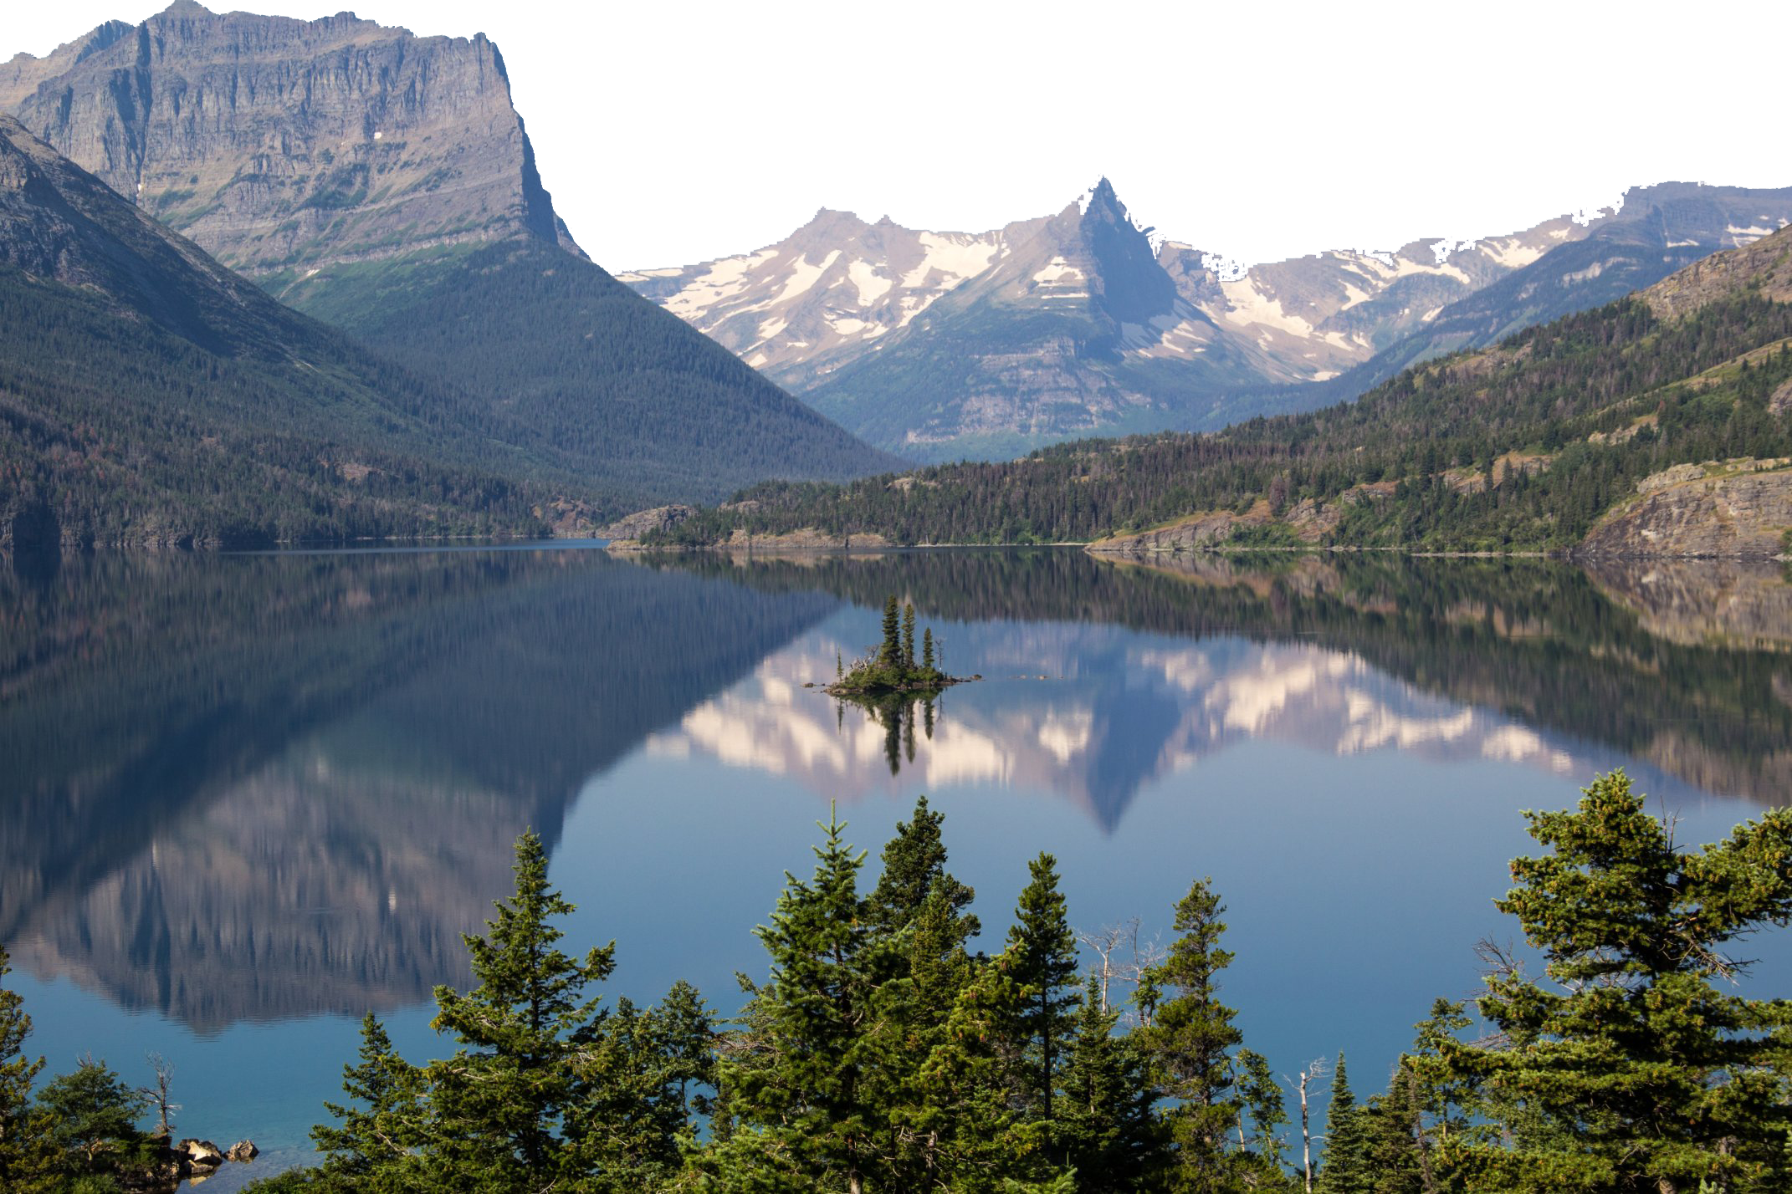
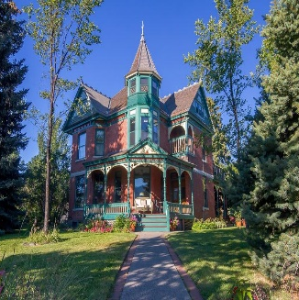
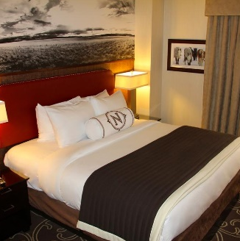
Popular Places
Professional Tourist Guide
Grand Teton National Park is adjacent to the southern end of Yellowstone National Park and covers an area of 485 square miles. The main river in the park: The Snake River runs through the north and south, winding several lakes.
We have professional tourist guides and intimate services to take you deep into the beauty of Yellowstone Park and you can enjoy this journey.
Grand Prismatic Spring is the largest hot spring in the USA. The color of the lake surface changes with the season. In spring, it changes from green to brilliant orange-red, and in summer, it appears orange, red, or yellow. In winter, it appears dark green.
The Old Faithful is not the largest fountain, nor the highest or the longest spraying fountain, but it is probably the most well-known fountain. Its eruption frequency is about 60 ~ 110 mins and eruption height is about 42 meters.
Hotels
The Black Sand Basin in the Upper Geyser District has a series of gem-like brilliant geysers and colorful springs. The emerald pond is the most abundant and prestigious spring in it. Its colors are emerald, green, orange, yellow, etc.
Grand Canyon of the Yellowstone formed in rock and sediments about 150,000 years ago. Past and current hydrothermal activity altered and weakened the rhyolite, making the rocks softer. The Yellowstone River eroded these weakened rocks to deepen and widen the canyon, a process that continues today.

